Slide 1
Star Track
Generating sufficient training data
Satellite Navigation with Machine Learning
Jacob Heglund
jheglun2@Illinois.edu

Slide 2
Problem Motivation
Extremely accurate and consistent for “lost in space” problem
Inexpensive star tracking systems at least $100,000
Limited modern research in ML applications to star tracking (Hong et. al. 2000, Trask 2002, Li et. al. 2003)

Slide 3

Star Tracking

Slide 4
Star Tracking

Slide 5
Star Tracking

Slide 6
Tycho Skymap
384 MB image of the celestial sphere
Generated by data from the Tycho satellite mission

Slide 7
Simulation t = 0 sec

Slide 8
Simulation t = 5 sec

Slide 9
Simulation t = 10 sec

Slide 10
Recurrent Neural Nets
Networks that can learn patterns over time
Applications: learning sequences that evolve in time (word prediction, music recognition, robot control)
Major Problem: Vanishing gradients during backprop
Information lost before it can traverse the entire network

Slide 11
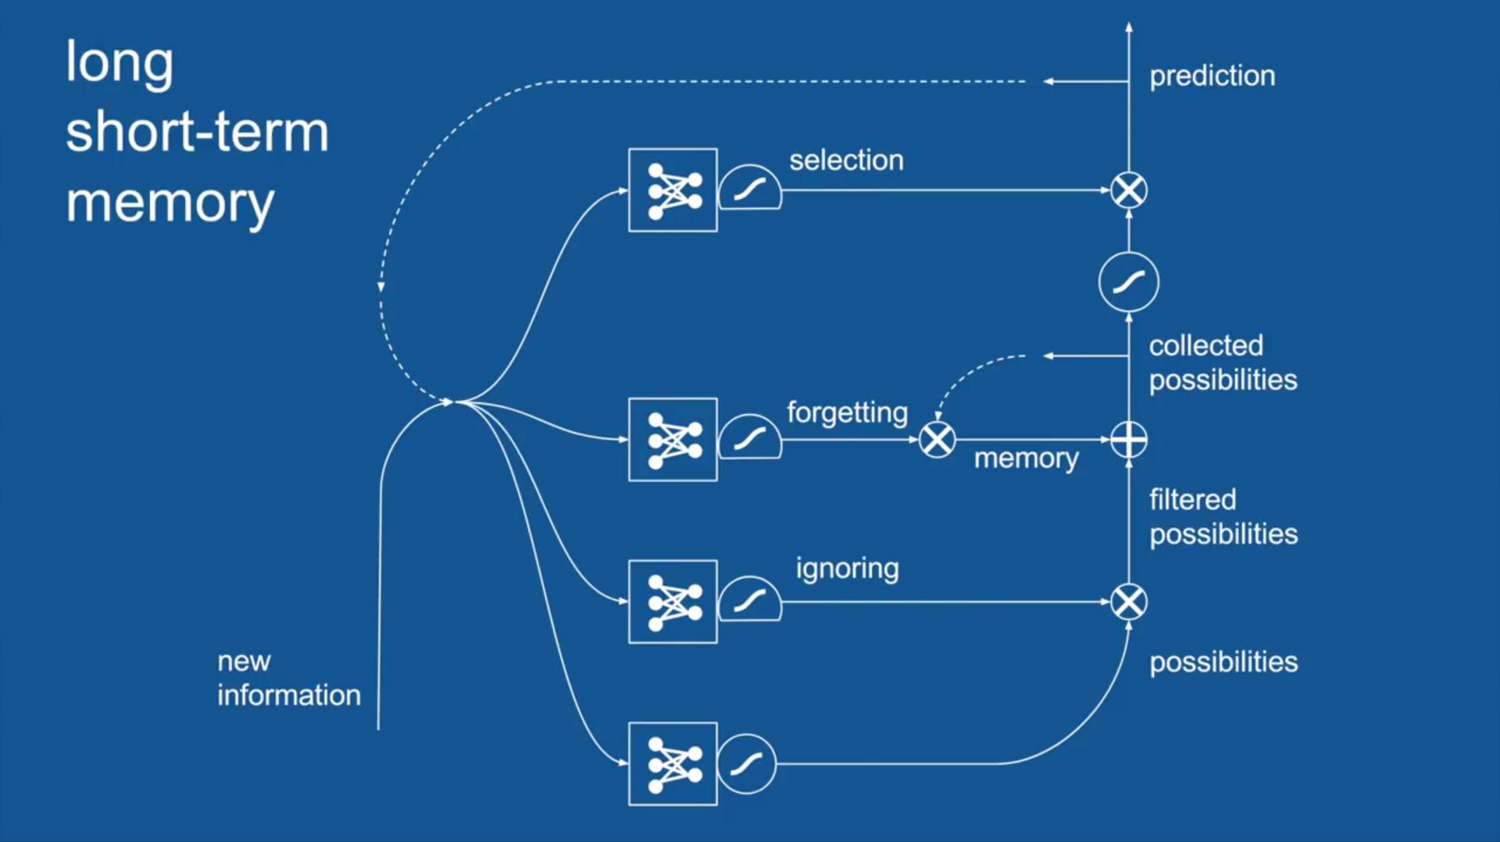
LSTM

Slide 12
Future Work
Generating sufficient training data
Implementation of LSTM in TensorFlow / Keras
Optimizing hyperparameters

Slide 13
Questions?

Slide 14
References
Li, C., Li, K., Zhang, L., Jin, S., & Zu, J. (2003). Star pattern recognition method based on neural network. Chinese Science Bulletin, 48(18), 1927-1930.
Hong, J., & Dickerson, J. A. (2000). Neural-network-based autonomous star identification algorithm. Journal of Guidance, Control, and Dynamics, 23(4), 728-735.
Trask, A. J. (2002). Autonomous artificial neural network star tracker for spacecraft attitude determination (Doctoral dissertation).
Ho, K. (2012). A survey of algorithms for star identification with low-cost star trackers. Acta Astronautica, 73, 156-163.
Spratling, B. B., & Mortari, D. (2009). A survey on star identification algorithms. Algorithms, 2(1), 93-107.
Krizhevsky, A., Sutskever, I., & Hinton, G. E. (2012). Imagenet classification with deep convolutional neural networks. In Advances in neural information processing systems (pp. 1097-1105).
Hochreiter, S. (1998). The vanishing gradient problem during learning recurrent neural nets and problem solutions. International Journal of Uncertainty, Fuzziness and Knowledge-Based Systems, 6(02), 107-116.

